Slide 1

Interest Meeting
Wed. Sept 16th @ 7pm EST

Slide 2

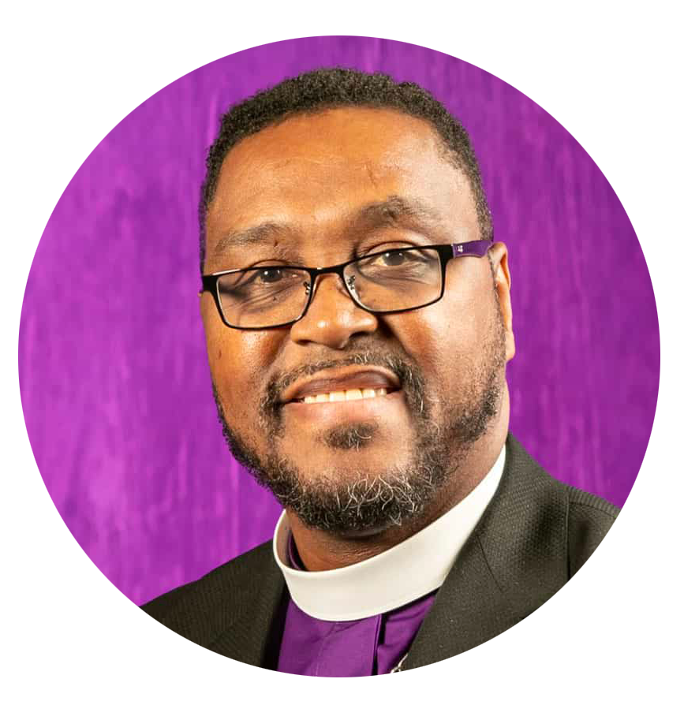
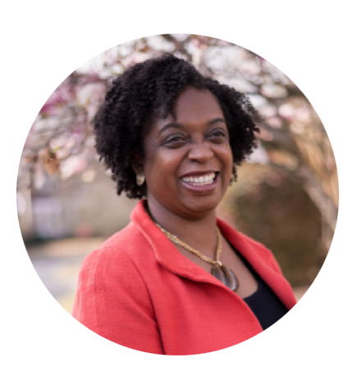
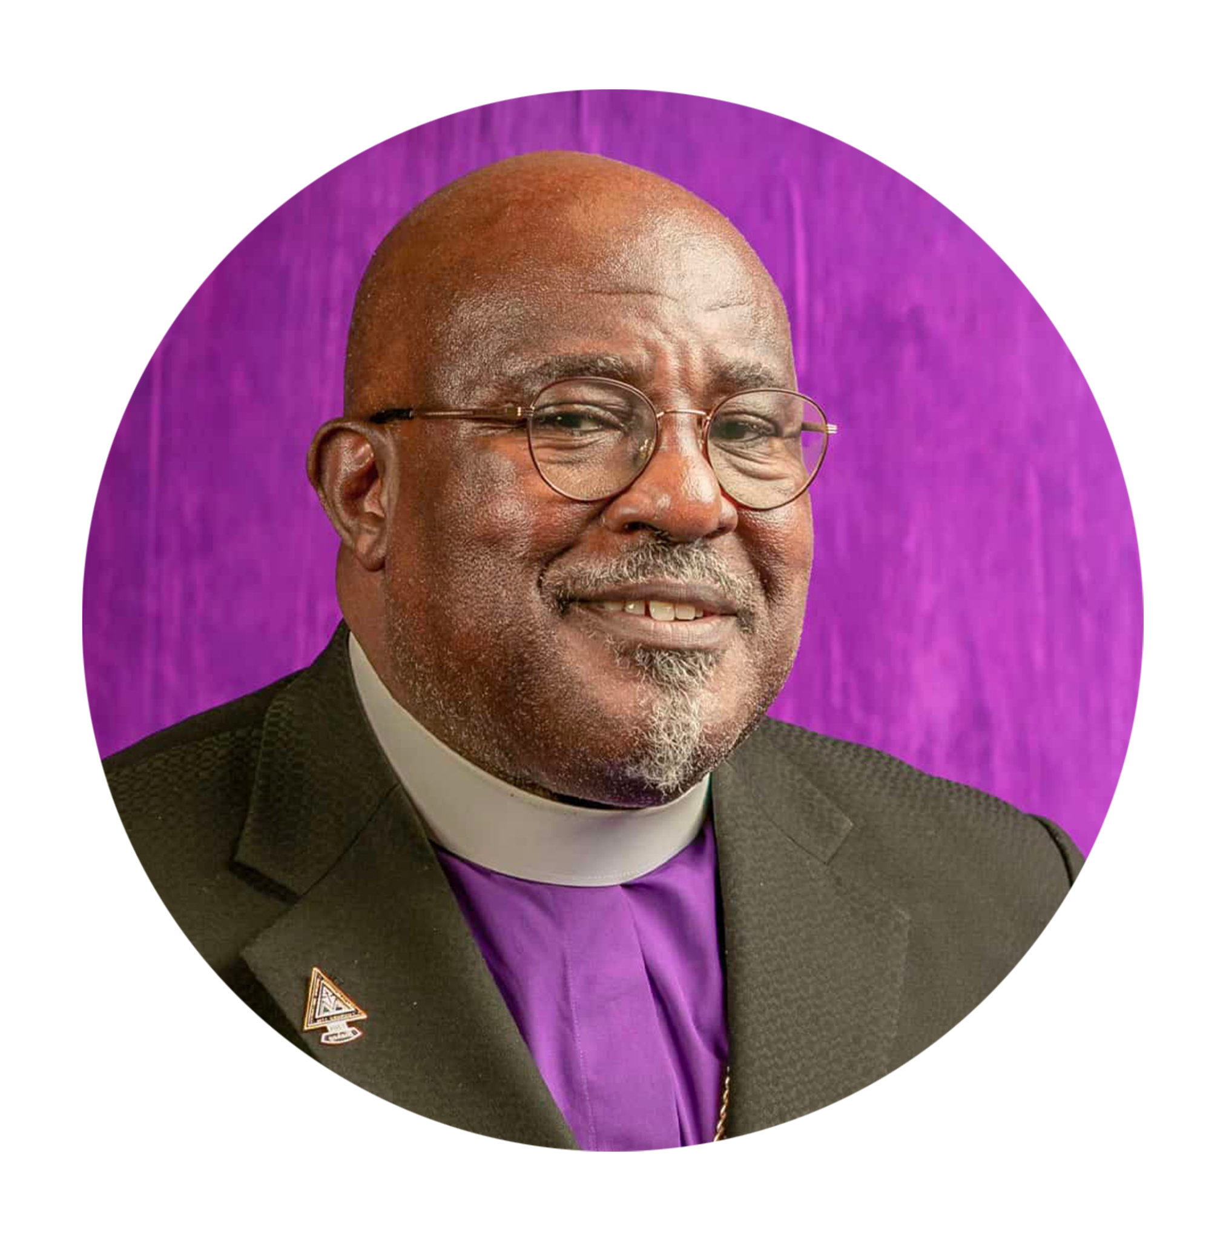
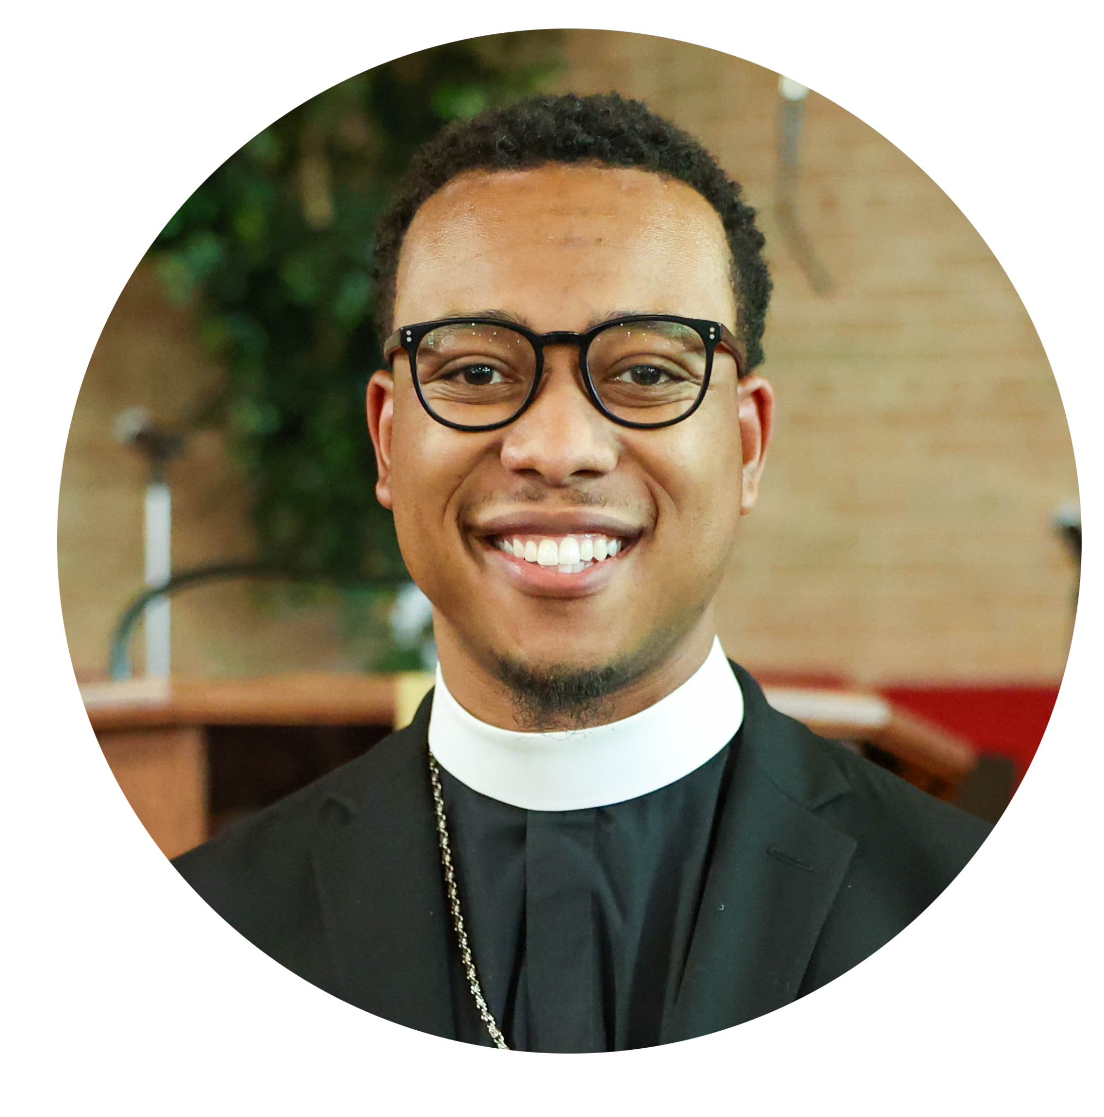
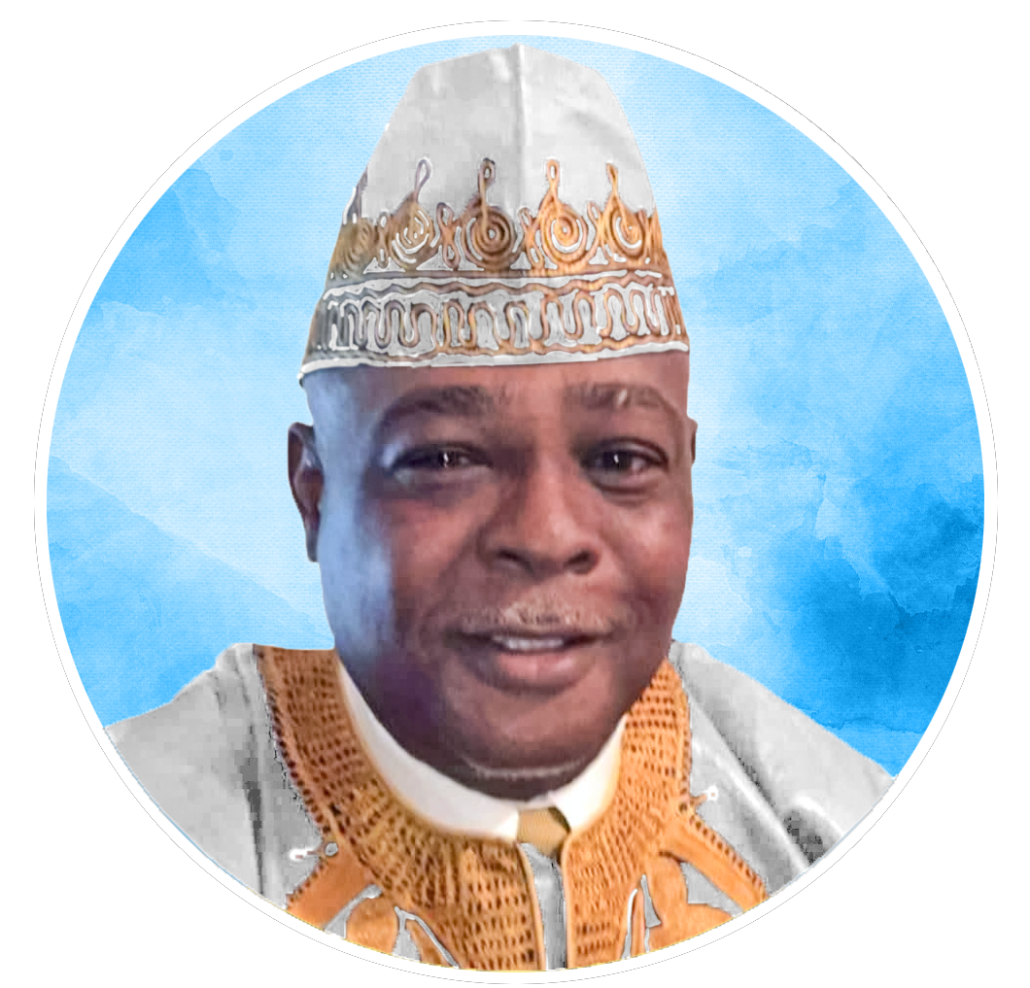
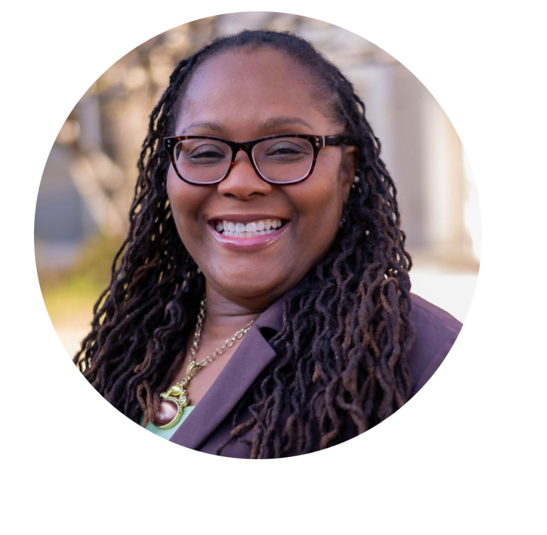
Leadership
Iyabode (Yabo) Beysolow, MD, MPH
Director, Global Medical Missions,
Director, Health Ministry AME Zion Church
Presiding Elder Austin Young
Presiding Elder of Trinidad & Tobago Conference
Bishop George D. Crenshaw
Board Chairman, Global Missions
Bishop Daran H. Mitchell
Mid-West Episcopal District
Rev. Dr. Dwight B. Cannon
Executive Director, Global Missions
Editor in Chief,
The Missionary Seer
Reverend Andrea Afolabi-Jallah, RN, BSN, MPH
Minister, Shaw Temple
  AME Zion
Episcopal Area Health
  Coordinator, South Atlantic

Slide 3
Agenda 1
Opening Prayer
Opening Remarks – Bishop Crenshaw
Opening Remarks – Dr. Cannon
Introduction of the US Leadership/Planning Team – Sis. Evette (also Meeting Moderator)
Introduction of the Trinidad Leadership/Planning Team – Elder Young/Deaconness Moses
Global Missions Medical/Dental Overview – Dr. Beysolow and Rev. Jallah
  What to expect on the Mission Field, Daily Schedule, Clinic location, The ideal Mission Workers, Roles and Responsibilities
  Dental – Dr. Dove
Leadership Training Institute Overview – Dr. Merriweather and Elder Young
Trinidad – The Culture, The People, The Food, Lodging (Brix Hotel) – Trinidad Leadership Team
Trip package Cost: Travel, Lodging, Food, Ground Transport, Tours, Trip Cost – Sis. Evette
  Air travel to Trinidad (Suggested airlines) - Airfare to/fro Trinidad NOT included in trip costs

Slide 4

Agenda 2
Meals – breakfast at hotel, lunch on field/tour, dinner at hotel/nearby restaurant
Ground Transport daily
Tours: 10th and 15th
Give away items – Collection and Shipping - TBD
Q and A
Next Steps – Sis. Evette and Dr. Cannon
  Registration
  Deposit
  Forms (Trip Covenant, General Contact Information)
  Payment schedule
  Meeting cadence from September – July 2027
Next Steps for Medical and Dental Team – Dr. Beysolow
  Medical questionnaires, Vaccines, etc.

Slide 5
Team Introductions
U.S. Planning and Leadership Team - Sis. Evette
Trinidad Planning and Leadership Team – Elder Young/Deaconess Moses

Slide 6
Leadership
Iyabode (Yabo) Beysolow, MD, MPH
Director, Global Medical Missions,
Director, Health Ministry AME Zion Church
Presiding Elder Austin Young
Presiding Elder of Trinidad & Tobago Conference
Bishop George D. Crenshaw
Board Chairman, Global Missions
Bishop Daran H. Mitchell
Mid-West Episcopal District
Rev. Dr. Dwight B. Cannon
Executive Director, Global Missions
Editor in Chief,
The Missionary Seer
Reverend Andrea Afolabi-Jallah, RN, BSN, MPH
Minister, Shaw Temple
  AME Zion
Episcopal Area Health
  Coordinator, South Atlantic

Slide 7
Medical/Dental Missions Overview
Dr. Beysolow and Rev. Jallah

Slide 8

PRIOR MEDICAL MISSION TRIPS
FOUR (4) TO LIBERIA: 2008 – 2013
ONE (1) TO ANGOLA – 2019
ONE (1) TO RWANDA – 2024
ONE (1) TO LIBERIA - 2026

Slide 9

What to expect on a Medical/Dental Mission Trip
Video from Liberia Trip 2026
Humility, Respect, Sharing the Love of Christ
Working alongside our medical/dental colleagues in Trinidad
Quality over quantity
We are not “saviors”
Focus on:
Prevention of chronic diseases (hypertension, diabetes), Health education – healthy living, nutrition, disease prevention
Diagnosis and treatment of acute conditions (fevers, colds, infections, etc)
Counseling and management of chronic conditions
Dental cleaning and screenings
Referral to local Healthcare system for ongoing care

Slide 10

What to Expect on a Medical/Dental Mission Trip

Slide 11
What will patients receive?
Free medical and dental care
  Free lab screenings (A1C, Cholesterol, hemoglobin)
  Treat acute illness (infections, etc)
  Free counseling and health education on chronic diseases
  Dental cleanings and screenings, dental hygiene
Free reading glasses
Free prescription medicine and medical supplies
Free give-away bags, clothing, shoes, and toiletries
Hot meal, Water and Snacks
Love and respect

Slide 12

Daily Schedule
August 9
Travel Day.
Arrive hotel
Dinner, Rest
August 10
Breakfast
Orientation
Tour of Clinic & City
Clinic
Clinic
Concurrent
Leadership
Institute
August 11-14
August 15
Rest Day
Tours
August 16
Travel Day
August 17-19
Excursion-
OPTIONAL
Details at
Next Meeting

Slide 13
Typical Clinic Day
6:30am | Breakfast
7:15am | Leave hotel for clinic site
8:15am | Arrive clinic site
8:15 – 9:00am | Prayers, Clinic Huddle, Set up Rooms. (Longer on Day 1)
9:00am | Start to see patients. Concurrent Leadership Training Institute
11:30am - 1:00pm | Lunch served – Rotation so clinic remains open
1:00pm | Registration closed to new patients for the day
2:30pm | Clinic shuts down and items secured for next day (Final clinic day, shut down at 1 pm)
3:30pm | Board bus to head back to hotel
 | Dinner, Debrief and Rest

Slide 14
Clinic Flow - Stations
Registration
Triage
Medical Team (Adults/Kids)
Dental Team
Health Education Team
Laboratory
Pharmacy
Giveaway station (Reading glasses, Clothing, Toiletries etc) and FOOD
Discharge
Each medical/dental provider can see up to 4 to 5 patients per hour (depending on complexity etc).
Total number of registrants per day will be based on staffing and capacity at each station.

Slide 15
What will my role be during the Mission Team?
Non-Medical Roles
Non-Medical Roles
Medical Roles
Registration
Give-Away Items
Food service Team
Runners
Photographer
Communications/IT
Sunday School/Bible Study
Baggage Control/Airport Surveillance
Crowd Control
Security
Eyeglass Station
Ministerial Team
Mission Team Welfare
Medical Services
Dental Services
Nursing Triage
Health Education

Slide 16
Staying Healthy
VACCINES strongly recommended (Always speak to your Doctor(PCP) before receiving any vaccines).
  COVID-19 (2026-27 or 2027-28 version) – receive when your PCP recommends
  Flu (2026-7 or 2027-8 version) – receive when your PCP recommends
  Routine:
  Chicken pox
  Tetanus Booster (every 10 years)
  Measles, Mumps and Rubella (MMR)
  Hep A and Hep B – if never received, get them now.

Slide 17
Staying Healthy
  Routine Continued:
    Polio – if never received, get it now.
    Shingles (50 +)
    Typhoid (TBD)
    Other vaccines as recommended by your healthcare provider
At least 2 months prior to travel (no later than May 31, 2027), make an appointment with your PCP or call their office for:
    a refill on all your prescription medications
    Clearance letter/statement from your healthcare provider to state you may travel

Slide 18
Traveler requirements
Being able to care for self
  If traveling alone (without spouse/family member), traveler must be an independent traveler (does not need a chaperone)
    No chaperones available
  Youth: 16 years and older may travel - but only with parent/legal guardian accompanying

Slide 19
To Help Ensure a Safe Trip
Fall Prevention
Ability to lift 25 pounds easily
Ability to walk a mile a day
Ability to sit, stand easily
Underlying Medical conditions that may put you at risk of serious illness during travel
Clearance letter needed from your healthcare provider
All travelers will be asked to complete a medical form listing your active medical conditions and medications. This will be reviewed and kept confidential by the Medical planning team.

Slide 20
The Ideal Mission Team Member
Willing to work hard (long days 10-12 hours — sometimes in extreme conditions)
Takes initiative
Leader/Follower – good balance of both
Team player
Understands group dynamics and keeps harmony
Problem solver

Slide 21
Who are we recruiting for?
Non-medical to help with all the roles we discussed. (3-5:1 ratio for every provider)
Medical
    Optometrists/Opthalmologists
    Podiatrists (foot doctors)
    OB/GYN and Family Practice Docs
    Pediatricians
    RNs
    Dentists
    Dental Assistants
    CNAs, CMAs

Slide 22
Leadership Training Institute Overview
Dr. Merriweather/Elder Young

Slide 23

Trinidad –
The Culture, The People, The Food
Trinidad Leadership Team

Slide 24
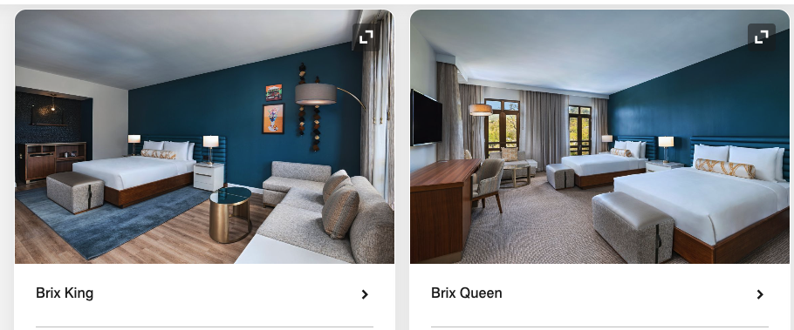

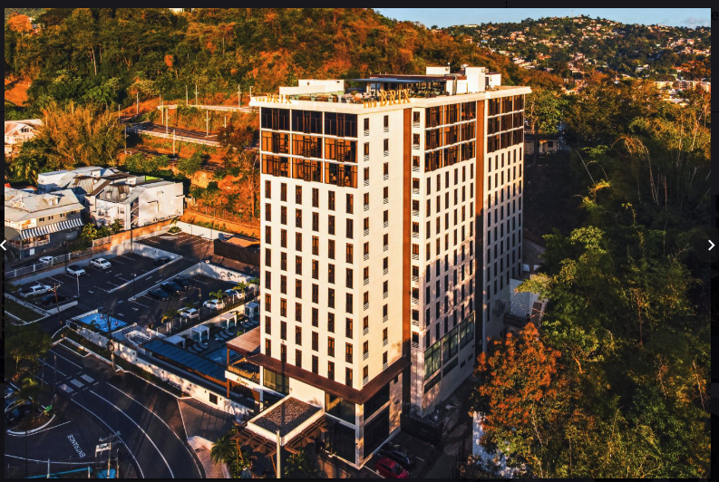
BRIX Hotel
Port of Spain
Brix King Size
Brix Queen Size

Slide 25
Trip Cost: Lodging, Food, Ground Transport, Tours
Sis. Evette Lewis

Slide 26
Trip Costs
Description | Single Traveler (no roommate) | Double Occupancy (has 1(one) roommate)
 | $3200.00 per person (7 nights, 8 days) | $2500.00 per person (7 nights, 8 days)
Includes: Ground transportation (Airport pickup 8/9 in Trinidad with the rest of the team, Airport dropoff 8/16 with the rest of the team), Daily bus transport 10-15th with the team. Lodging 8/9 check in - 8/16 check out at Brix Hotel Daily meals (breakfast, Lunch and dinner - beginning with dinner on 8/9 and ending with breakfast on 8/16). Airport meals NOT included. Daily Tips for Drivers, restaurant staff. You may still tip extra if you wish to. Does NOT include hotel room tips. Please tip hotel room staff daily. Tour on 8/10 - half day brief city tour Tour on 8/15 - full day city and beach tour Does NOT include: Airfare to and from Trinidad from the U.S. or other country. Stay in Trinidad prior to 8/9 (evening) or after 8/16 (morning) Visa costs if non-US citizen (U.S. citizens do not require a visa to Trinidad) Vaccine costs

Slide 27
Payments
Description | Single Occupancy | Double Occupancy
Deposit (non-refundable after January 15, 2027) | $500 | $500
Quarterly payments # 1: deadline November 15, 2026 (non-refundable after January 15, 2027) | $675 | $500
Quarterly payment # 2: deadline February 15, 2027 (NON-Refundable) | $675 | $500
Quarterly payment # 3: deadline May 15, 2027 (NON-refundable) | $675 | $500
Final payment # 4: deadline July 15, 2027 (NON-refundable) | $675 | $500
Total | $3200 | $2500

Slide 28
Q and A

Slide 29
Next Steps – Trip Registration
Visit the Global Missions Website:
www.globalmissionszion.org
Link to register
https://www.globalmissionszion.org/mission-medical-registration

Slide 30
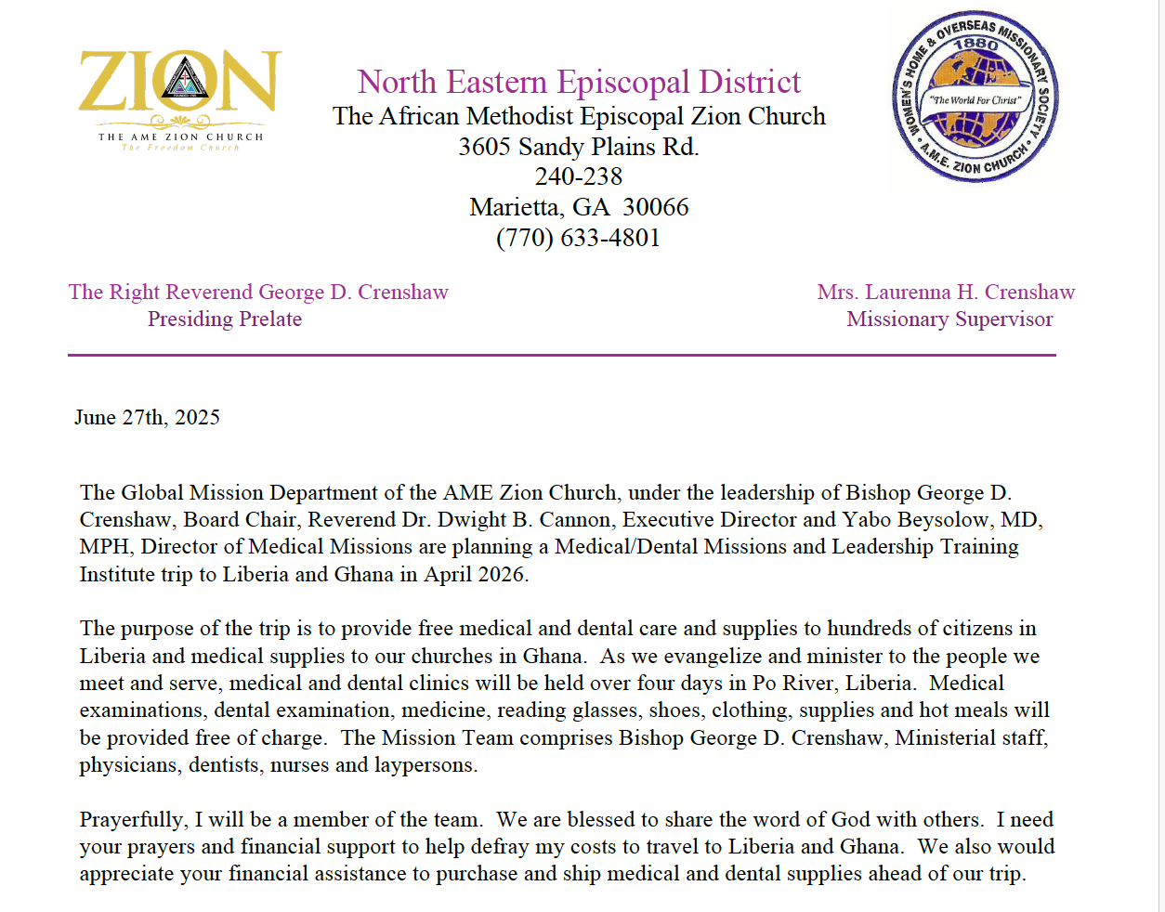
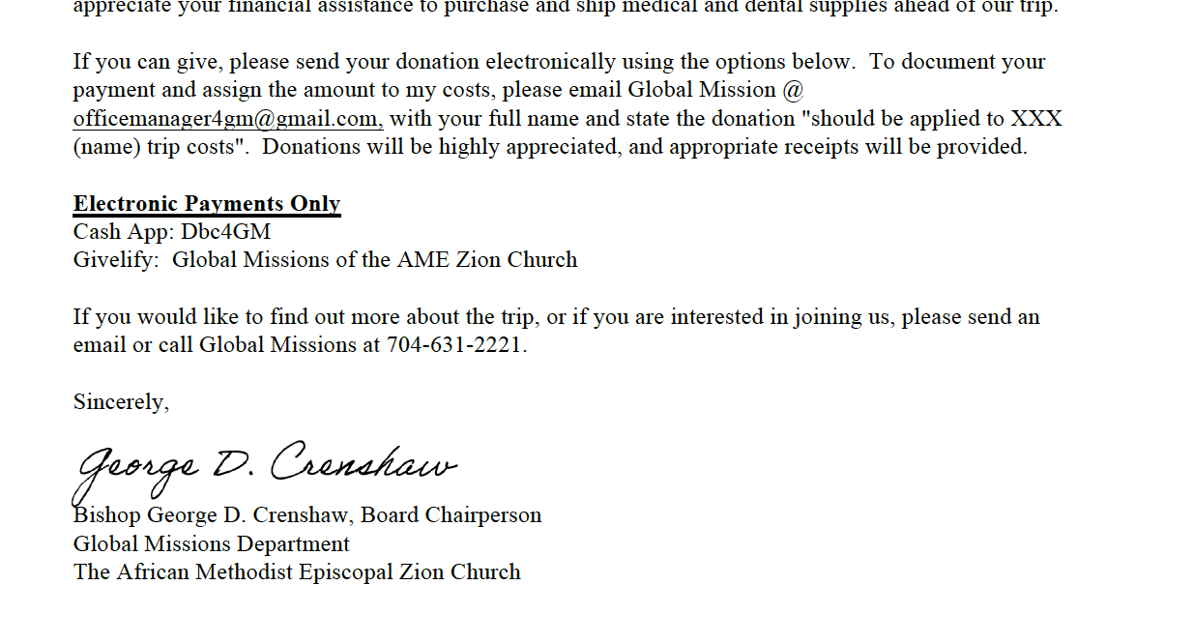
Soliciting Donations towards your trip

Slide 31

Give away items-
List of needed items
Collection and Shipping - TBD

Slide 32
Next Steps – Excursion at Conclusion of Mission Trip
Possible Dates: 8/16 - 8/19
Who is interested?
Pricing and details pending

Slide 33
Next Steps – Medical/Dental
Dr. Beysolow and Rev. Jallah
Confidential Medical Forms to complete – all Travelers
Medical/Dental Teams – Temporary Licenses and Applications needed ASAP (completed applications needed no later than 9/30/26)

Slide 34
Future Meeting Dates
Second Interest Meeting - Thurs. October 8, 2026 at 7 pm EST
Team meetings - 4th Thursday of every month at 7 pm EST (proposed)
October 2026
November 2026
December 2026
January 2027
February 2027
March 2027
April 2027
May 2027
June 2027
July 2027
Exception: August 5, 2027
All team members are required to attend our monthly meetings. This allows opportunities to connect with one another, and understand roles and responsibilities and share in the vision for a successful Mission Trip.

Slide 35
Contacts
Trip Registration, Payments, General questions:
Evette Lewis: officemanager4gm@gmail.com
Medical/Dental Provider questions & Medical travel questions:
Dr. Beysolow: drbeysolow@amezion.org
Rev. Jallah: a2j5@hotmail.com

Slide 36
Closing Prayer
Thank you

